Slide 1
COMP 3500 Introduction to Operating Systems The Banker’s Algorithm (cont.) Deadlock Detection
Dr. Xiao Qin
Auburn University http://www.eng.auburn.edu/~xqin
xqin@auburn.edu
Slides are adopted from Drs. Silberschatz, Galvin, and Gagne
Notes:
50 Min: slides 1-14

Slide 2
Review: Deadlock Prevention Circular Wait
Impose a total ordering of all resource types, and require that each process requests resources in an increasing order of enumeration
Process 1
Should Process 2 wait for Process 1?
Process 2

Slide 3
Example of The Banker’s Algorithm
5 processes P₀ through P₄;
3 resource types:
A (10 instances), B (5instances), and C (7 instances)
Snapshot at time T₀:
Allocation Max Available
A B C A B C A B C
P₀ 0 1 0 7 5 3 3 3 2
P₁ 2 0 0 3 2 2
P₂ 3 0 2 9 0 2
P₃ 2 1 1 2 2 2
P₄ 0 0 2 4 3 3
Need
A B C
P0 7 4 3
P1 1 2 2
P2 6 0 0
P3 0 1 1
P4 4 3 1

Slide 4
What happens in this example? P₁ requests (1,0,2)
Allocation Max Available
A B C A B A B C
P₀ 0 1 0 7 5 3 3 3 2
P₁ 2 0 0 3 2 2
P₂ 3 0 2 9 0 2
P₃ 2 1 1 2 2 2
P₄ 0 0 2 4 3 3
Q1: Can the request of P1 be granted? Why?
Before
Check that Request ≤ Available (that is, (1,0,2) ≤ (3,3,2) ⇒ true
Allocation Need Available
A B C A B C A B C
P₀ 0 1 0 7 4 3 2 3 0
P₁ 3 0 2 0 2 0
P₂ 3 0 2 6 0 0
P₃ 2 1 1 0 1 1
P₄ 0 0 2 4 3 1
Q2: How to update the “Allocation”, “Need”, and Available data?
After

Slide 5
Ex1: Can requests of P4 and P0 be granted?
Allocation Need Available
A B C A B C A B C
P₀ 0 1 0 7 4 3 2 3 0
P₁ 3 0 2 0 2 0
P₂ 3 0 2 6 0 0
P₃ 2 1 1 0 1 1
P₄ 0 0 2 4 3 1
Given a sequence of <P4, P0>,
Q3: Can request for (3,3,0) by P₄ be granted? Why?
Q4: Can request for (0,2,0) by P₀ be granted?
Notes:
Q3: No. request > available
Q4: No. P4 is not granted.

Slide 6
Q5: Can you design an algorithm to detect if a system is in a safe state?
The content of the matrix Need is defined to be Max – Allocation
Need
A B C
P₀ 7 4 3
P₁ 1 2 2
P₂ 6 0 0
P₃ 0 1 1
P₄ 4 3 1
The system is in a safe state since the sequence < P₁, P₃, P₄, P₂, P₀> satisfies safety criteria

Slide 7
Safe State
When a process requests a resource, system must decide if allocation leaves the system in a safe state
System is in safe state if there exists a sequence <P₁, P₂, …, P_{n}> of ALL the processes in the systems such that for each P_{i}, the resources that P_{i} can still request can be satisfied by currently available resources + resources held by all the P_{j}, with j < I
Notes:
When a process requests a resource, system must decide if allocation leaves the system in a safe state
System is in safe state if there exists a sequence <P₁, P₂, …, P_{n}> of ALL the processes in the systems such that for each P_{i}, the resources that P_{i} can still request can be satisfied by currently available resources + resources held by all the P_{j}, with j < I
That is:
If P_{i} resource needs are not immediately available, then P_{i} can wait until all P_{j} have finished
When P_{j} is finished, P_{i} can obtain needed resources, execute, return allocated resources, and terminate
When P_{i} terminates, P_{i +1} can obtain its needed resources, and so on

Slide 8

Safety Algorithm Is a system is in a safe state?
1. Let Work and Finish be vectors of length m and n, respectively. Initialize:
Work = Available
Finish [i] = false for i = 0, 1, …, n- 1
2. Find an i such that both:
(a) Finish [i] = false
(b) Need_{i} ≤ Work
If no such i exists, go to step 4
3. Work = Work + Allocation_{i} Finish[i] = true go to step 2
4. If Finish [i] == true for all i, then the system is in a safe state
n is the number of processes, m is the number of resource types

Slide 9

Ex2: Resource-Request Algorithm for Process P_{i}
Request_{i} = request vector for process P_{i}. If Request_{i} [j] = k then process P_{i} wants k instances of resource type R_{j}
1. If Request_{i} ≤ Need_{i} go to step 2. Otherwise, raise error condition, since process has exceeded its maximum claim
2. If Request_{i} ≤ Available, go to step 3. Otherwise P_{i} must wait, since resources are not available
3. Pretend to allocate requested resources to P_{i} by modifying the state as follows:
Available = Available – Request_{i};
Allocation_{i} = Allocation_{i} + Request_{i};
Need_{i} = Need_{i} – Request_{i};
If safe ⇒ the resources are allocated to P_{i}
If unsafe ⇒ P_{i} must wait, and the old resource-allocation state is restored
Q7: Conditions?
Q6: How to modify the state?

Slide 10
Deadlock Detection
Allow system to enter deadlock states
A detection algorithm
A recovery scheme

Slide 11

Single Instance of Each Resource Type
Q8: How to detect deadlocks?
Maintain wait-for graph
Nodes are processes
P_{i} → P_{j} if P_{i} is waiting for P_{j}
Periodically invoke an algorithm that searches for a cycle in the graph. If there is a cycle, there exists a deadlock
An algorithm to detect a cycle in a graph requires an order of n² operations, where n is the number of vertices in the graph

Slide 12
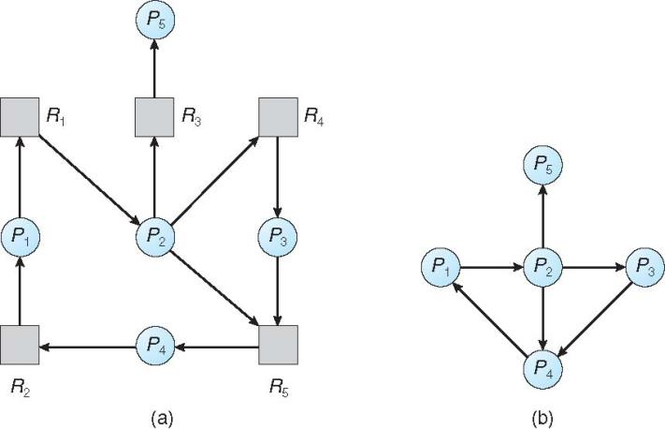

Ex3: Resource-Allocation Graph and Wait-for Graph
Q9: Please draw a corresponding
wait-for graph.
Resource-Allocation Graph
Corresponding wait-for graph

Slide 13
Several Instances of a Resource Type
Available: A vector of length m indicates the number of available resources of each type
Allocation: An n x m matrix defines the number of resources of each type currently allocated to each process
Request: An n x m matrix indicates the current request of each process. If Request [i][j] = k, then process P_{i} is requesting k more instances of resource type R_{j}.

Slide 14
Detection Algorithm
1. Let Work and Finish be vectors of length m and n. Initialize:
(a) Work = Available
(b) For i = 1,2, …, n, if Allocation_{i} ≠ 0, then Finish[i] = false; otherwise, Finish[i] = true
2. Find an index i such that both:
(a) Finish[i] == false
(b) Request_{i} ≤ Work
If no such i exists, go to step 4
3. Work = Work + Allocation_{i} Finish[i] = true go to step 2
4. If Finish[i] == false, for some i, 1 ≤ i ≤ n, then the system is in deadlock state. Moreover, if Finish[i] == false, then P_{i} is deadlocked
Q10: What do you observe in this
detection algorithm?
Time Complexity: O(m x n²)
Notes:
Similar to the safety algorithm

Slide 15
Example of Detection Algorithm
Five processes P₀ through P₄; three resource types A (7 instances), B (2 instances), and C (6 instances)
Snapshot at time T₀:
Allocation Request Available
A B C A B C A B C
P₀ 0 1 0 0 0 0 0 0 0
P₁ 2 0 0 2 0 2
P₂ 3 0 3 0 0 0
P₃ 2 1 1 1 0 0
P₄ 0 0 2 0 0 2
Sequence <P₀, P₂, P₃, P₁, P₄> will result in Finish[i] = true for all i
Notes:
What does “Finish[i] = true for all i” mean?

Slide 16
Example (Cont.)
P₂ requests an additional instance of type C
Request
A B C
P₀ 0 0 0
P₁ 2 0 2
P₂ 0 0 1
P₃ 1 0 0
P₄ 0 0 2
State of system?
Can reclaim resources held by process P₀, but insufficient resources to fulfill other processes; requests
Deadlock exists, consisting of processes P₁, P₂, P₃, and P₄

Slide 17
Detection-Algorithm Usage
When, and how often, to invoke depends on:
How often a deadlock is likely to occur?
How many processes will need to be rolled back?
one for each disjoint cycle
If detection algorithm is invoked arbitrarily, there may be many cycles in the resource graph and so we would not be able to tell which of the many deadlocked processes “caused” the deadlock.

Slide 18

Recovery from Deadlock: Process Termination
Abort all deadlocked processes
Abort one process at a time until the deadlock cycle is eliminated
In which order should we choose to abort?
Priority of the process
How long process has computed, and how much longer to completion
Resources the process has used
Resources process needs to complete
How many processes will need to be terminated
Is process interactive or batch?
Q11: Which one do you prefer? Why?
Notes:
Abort all: easy implementation
Abort one: good performance

Slide 19
Recovery from Deadlock: Resource Preemption
Selecting a victim – minimize cost
Rollback – return to some safe state, restart process for that state
Starvation – same process may always be picked as victim, include number of rollback in cost factor

Slide 20
Summary
The Banker’s Algorithm
The Safety Algorithm
Resource-Request Algorithm
The detection algorithm
The recovery scheme

